Slide 1
FINAL PROJECTS
COMPUTER INFORMATION TECNOLOGY
CV RESUME
SPEED SHEET
ANALISE

Slide 2
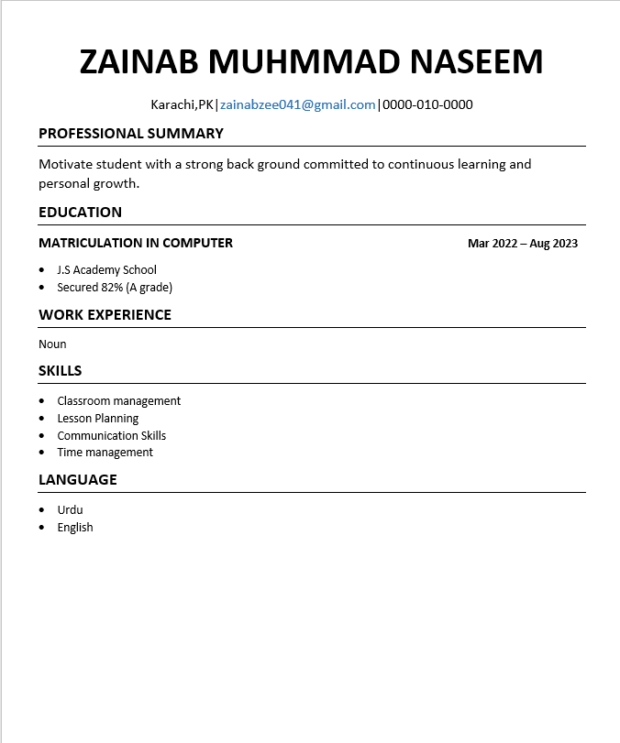
My Resume
Consists of five sections which includes my academic and professional details

Slide 3
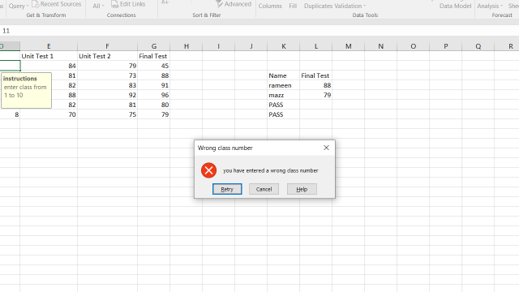
Data Validation
Here I have data validation and restricted to only enter a number between 1 to 10 and when he enters another number he gets an error.

Slide 4
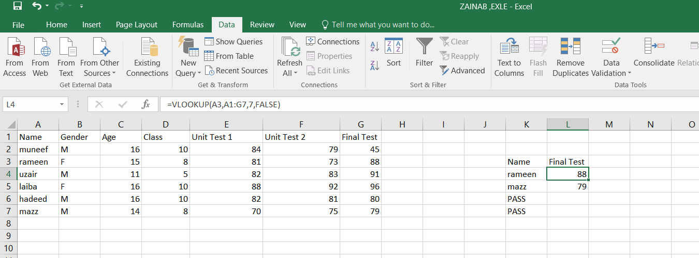
VLOOKUP in Excel
Vlookup in excel is used to lookup a certain value in any column

Slide 5
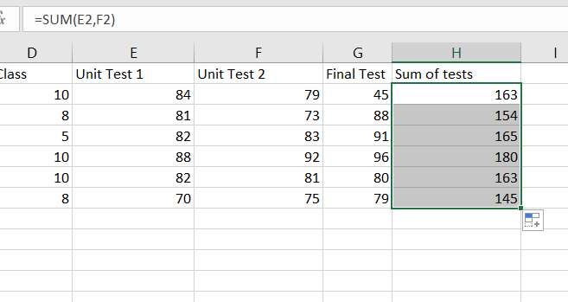
SUM in Excel
SUM ADD TO NUMBER

Slide 6
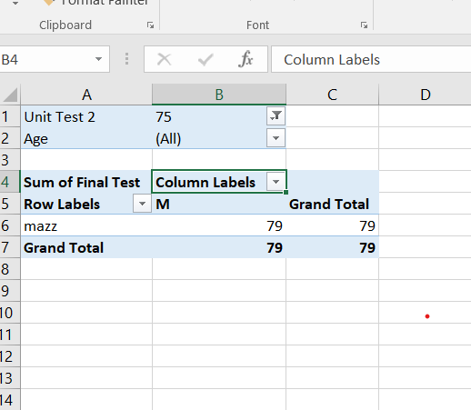
Pivot table in excel
I have created a pivot table in excel to sort and filter my data

Slide 7
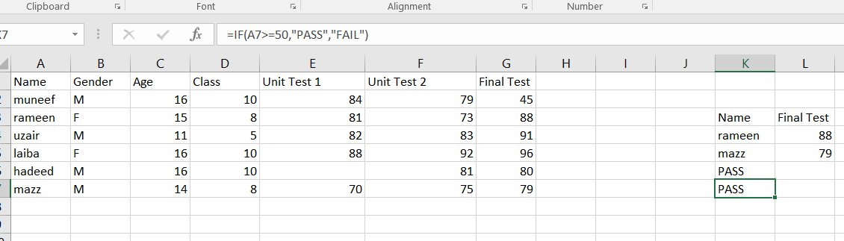
IF IN EXCEL

Slide 8
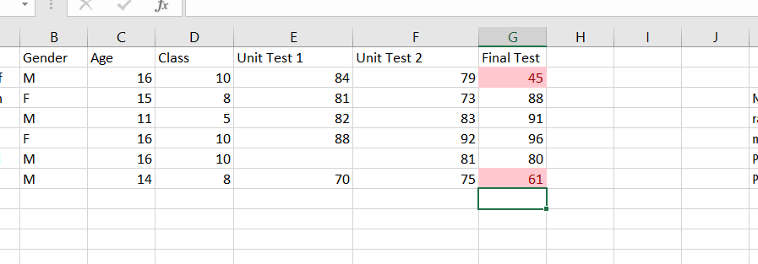
Conditional Formatting IN EXCEL

